Slide 1

Standard Work
Draw a Pig Exercise
© 2016 ImprovementHabit.org

Slide 2


What is Standard Work?
© 2016 ImprovementHabit.org

Slide 3
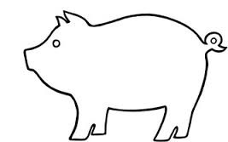
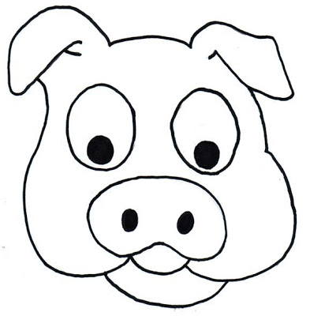
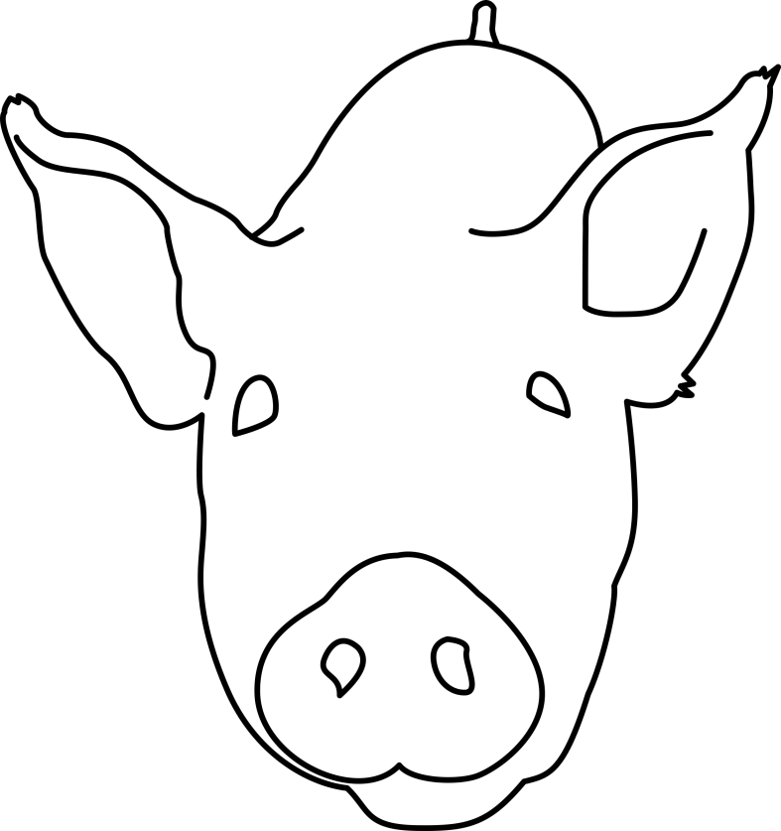
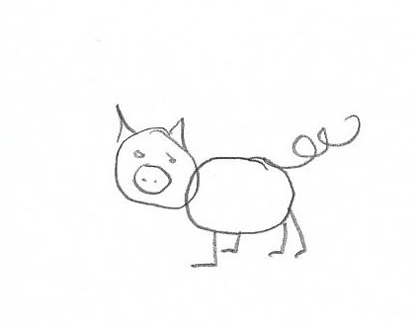
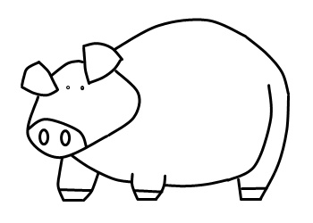
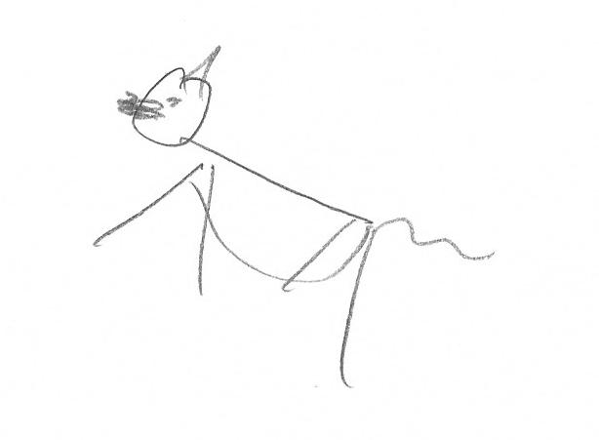
Activity 1: Draw a Pig
© 2016 ImprovementHabit.org

Slide 4
Activity 2: Draw a Pig with Instructions
In the NW quadrant, draw a capital M, so the tip of the middle V of the M touches the intersection of the grid lines
In the SW quadrant, draw a capital W, so the tip (^) of the W touches the intersection of the grid lines
In the SE quadrant, draw a capital W, so the tip (^) of the W touches the intersection of the grid lines
Go back to the M you drew in Step 1, and draw a slightly upwardly bowed line that runs from the most eastern point of the M, to the intersection of the grid lines in the NE quadrant.
Continue the line from step 4 the intersection of the grid lines in the NE quadrant to the most easterly point of the W that you constructed in the 3rd step.
Draw a downwardly bowed line from the most western point of the W in the SE quadrant, to the most easterly point of the W in the SW quadrant.
In the exact middle of the box between the NW quadrant and the SW quadrant, draw a circle the size of a dime.
Draw an inwardly bowed line from the most westerly point of the M created in Step 1, to the top of the circle you just drew in Step 7.
Draw an inwardly bowed line from the most westerly point of the W created in Step 2, to the bottom of the circle you drew in Step 7.
Draw a right-facing half-moon-shaped line about ½ inch in length starting from the middle of the line you created in Step 8.
Draw a left and upward-facing line about 1/3 inch in length starting from the middle of the line you drew in step 9.
Draw a curly-cue about 1 inch in length starting at the upper third of the line you created in Step 5, extending in an easterly direction.
Put two dots in middle of the circle you drew in Step 7, arranged horizontally, and about ¼ of an inch apart.
Source: Minnesota Department of Continuous Improvement
© 2016 ImprovementHabit.org

Slide 5

Does Your Pig Look Like This?
© 2016 ImprovementHabit.org

Slide 6
Activity 3: Draw Again with a Standardization Aid
1
8
5
10
9
12
4
11
6
7
2
3
Draw an M in position 1
Draw a W in position 2 & 3
Draw a circle w/ dots in the center at position 4
Draw lines 5 - 9
Draw lines 10 & 11
Draw a curly que at position 12
© 2016 ImprovementHabit.org

Slide 7
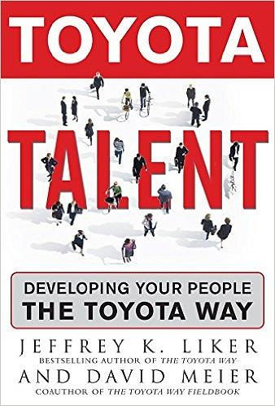


Definition from Lean Experts
“Standardized work is not to make all tasks highly repetitive; the intent is to define the best methods and to reduce variation in the work method as much as possible…” (as cited in Feng & Ballard, 2008, p. 5).
- Jeff Liker and David Meier
Feng, P. P., & Ballard, G. (2008). Standard Work from a Lean Theory Perspective. 16th Annual Conference of the International Group for Lean Construction Production Planning and Control, 1-10. Retrieved from https://www.academia.edu/2800125/Standard_Work_from_a_Lean_Theory_Perspective
© 2016 ImprovementHabit.org
Notes:
“Variability in work processes increases the probability of breakdowns (any deviation from an expected outcome), errors and negative iteration which leads to schedule and cost overruns. Standardizing work methods reduces the probability of breakdowns, thereby improving work flow, providing a basis for learning from what breakdowns do occur, and providing a basis for experimentation with alternative work method designs” (Feng & Ballard, 2008, p. 1).
“The main goals of production are to (1) produce products, (2) reduce costs, time, and materials for the production system, and (3) deliver customer needs based on quality, reliability and flexibility” (Feng & Ballard, 2008, p. 2).
“Standardized work is not to make all tasks highly repetitive; the intent is to define the best methods and to reduce variation in the work method as much as possible (liker and Meier 2007)” (as cited in Feng & Ballard, 2008, p. 5).

Slide 8
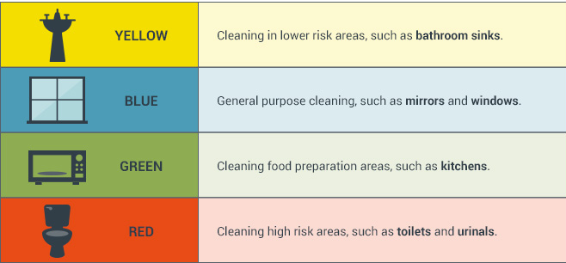
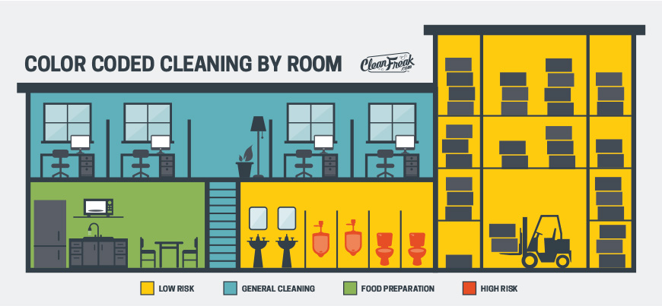
Standard Work Examples
Source: CleanFreak.com
© 2016 ImprovementHabit.org
Notes:
“Variability in work processes increases the probability of breakdowns (any deviation from an expected outcome), errors and negative iteration which leads to schedule and cost overruns. Standardizing work methods reduces the probability of breakdowns, thereby improving work flow, providing a basis for learning from what breakdowns do occur, and providing a basis for experimentation with alternative work method designs” (Feng & Ballard, 2008, p. 1).
“The main goals of production are to (1) produce products, (2) reduce costs, time, and materials for the production system, and (3) deliver customer needs based on quality, reliability and flexibility” (Feng & Ballard, 2008, p. 2).
“Standardized work is not to make all tasks highly repetitive; the intent is to define the best methods and to reduce variation in the work method as much as possible (liker and Meier 2007)” (as cited in Feng & Ballard, 2008, p. 5).

Slide 9
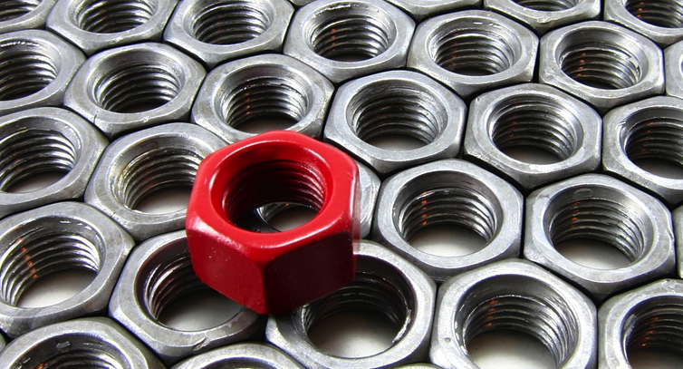
Standard Work Examples
© 2016 ImprovementHabit.org
Notes:
“Variability in work processes increases the probability of breakdowns (any deviation from an expected outcome), errors and negative iteration which leads to schedule and cost overruns. Standardizing work methods reduces the probability of breakdowns, thereby improving work flow, providing a basis for learning from what breakdowns do occur, and providing a basis for experimentation with alternative work method designs” (Feng & Ballard, 2008, p. 1).
“The main goals of production are to (1) produce products, (2) reduce costs, time, and materials for the production system, and (3) deliver customer needs based on quality, reliability and flexibility” (Feng & Ballard, 2008, p. 2).
“Standardized work is not to make all tasks highly repetitive; the intent is to define the best methods and to reduce variation in the work method as much as possible (liker and Meier 2007)” (as cited in Feng & Ballard, 2008, p. 5).

Slide 10
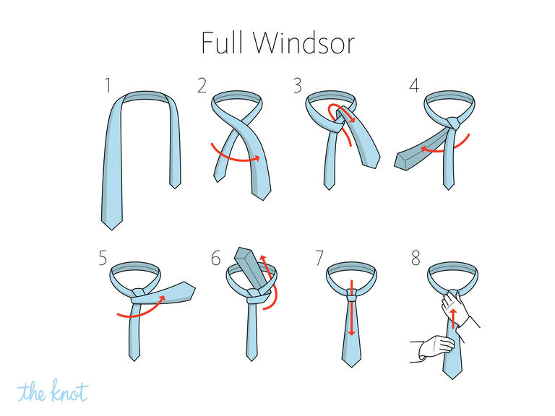
Standard Work Examples
Source: TheKnot.com
© 2016 ImprovementHabit.org
Notes:
“Variability in work processes increases the probability of breakdowns (any deviation from an expected outcome), errors and negative iteration which leads to schedule and cost overruns. Standardizing work methods reduces the probability of breakdowns, thereby improving work flow, providing a basis for learning from what breakdowns do occur, and providing a basis for experimentation with alternative work method designs” (Feng & Ballard, 2008, p. 1).
“The main goals of production are to (1) produce products, (2) reduce costs, time, and materials for the production system, and (3) deliver customer needs based on quality, reliability and flexibility” (Feng & Ballard, 2008, p. 2).
“Standardized work is not to make all tasks highly repetitive; the intent is to define the best methods and to reduce variation in the work method as much as possible (liker and Meier 2007)” (as cited in Feng & Ballard, 2008, p. 5).

Slide 11
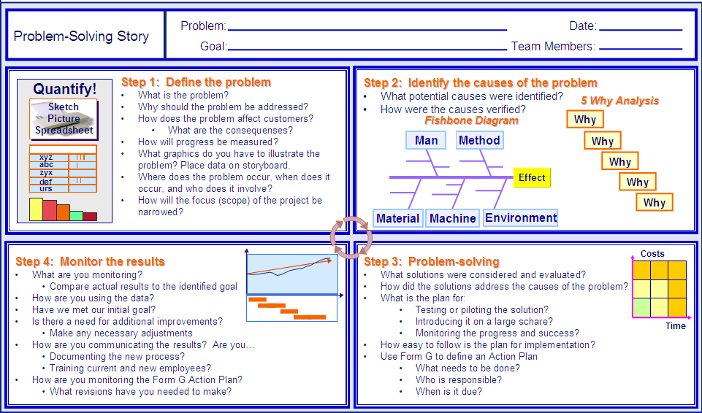
Standard Work Examples
People
Source: Lean New Hampshire
© 2016 ImprovementHabit.org
Notes:
BMGI: “An 'A3' is a report on an 11 x 17 piece of paper, whose name is derived from the European standard paper size by the same name. The report content typically follows the PDCA (Plan-Do-Check-Act) cycle, and is used to standardize and simplify status updates, proposals, and other methods of communication.” (BMGI, 2016). http://www.bmgi.org/glossary/a3

Slide 12
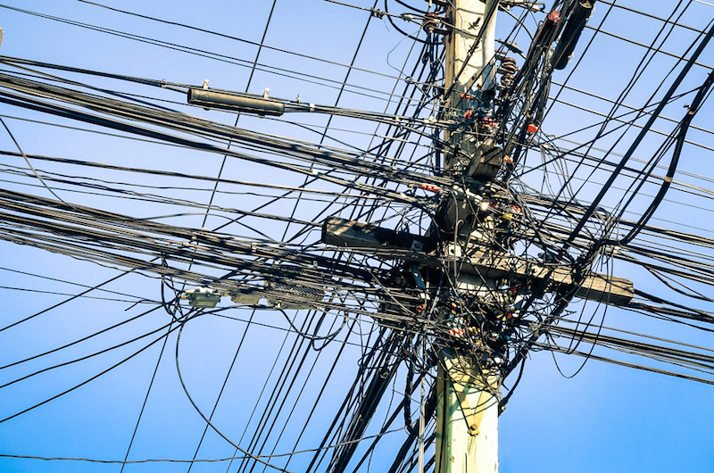
How Can You Use Standard Work?
?
© 2016 ImprovementHabit.org
Notes:
“Variability in work processes increases the probability of breakdowns (any deviation from an expected outcome), errors and negative iteration which leads to schedule and cost overruns. Standardizing work methods reduces the probability of breakdowns, thereby improving work flow, providing a basis for learning from what breakdowns do occur, and providing a basis for experimentation with alternative work method designs” (Feng & Ballard, 2008, p. 1).
“The main goals of production are to (1) produce products, (2) reduce costs, time, and materials for the production system, and (3) deliver customer needs based on quality, reliability and flexibility” (Feng & Ballard, 2008, p. 2).
“Standardized work is not to make all tasks highly repetitive; the intent is to define the best methods and to reduce variation in the work method as much as possible (liker and Meier 2007)” (as cited in Feng & Ballard, 2008, p. 5).

Slide 13
Standard Work
Main Sources
Acedemia.edu
BMGI
Feng, P. P., & Ballard, G
Liker, J. K. & Meier D.
Lean New Hampshire
Minnesota Department of Continuous Improvement
Draw a Pig Exercise
© 2016 ImprovementHabit.org

